Slide 1



HOTEL BOOKING CANCELLATION
PREDICTION
Subject: Machine Learning
Lecture : Mr. HIM Soklong
Project Member : Mr. Sothea Rach ID: CSE2024190033
Mr. Srey Tethtebveboth ID: CSE2024190017
Mr. Thun Mengthean ID: CSE2024190037
01

Slide 2
1
The project applies supervised machine learning to predict hotel booking cancellation
2
Dataset booking.csv — 36,285 bookings, 17 feature, 2 classes ( canceled / not canceled)
Overview
3
Four model implemented : logistic regression , random forest classifier , Decision Tree and K-Nearest Neighbors(KNN)
4
Four model tuned using GridSearchCV with stratified cross-validation
5
Evaluated using accuracy, procision, recall, f1 score, confusion matrix and Roc curve
6
Key drivers identified: lead time, special request , market segment and average price
02

Slide 3

TABLE CONTENT
Introduction
Data Description
EXPLORATORY DATA ANALYSIS(EDA)
Data Processing
Methodology
Findings
Conclusion
03

Slide 4


1. Introduction
Hotel Booking Cancellation Prediction
"Hotel cancellations cost businesses money and mess up planning. My project predicts if a booking will be canceled, before it happens, using real data from over 36,000 hotel bookings. I looked at things like booking lead time, price, and customer type. Bookings made far in advance cancel much more often, while guests with special requests almost never cancel. The goal is to help hotels act early, instead of getting surprised."
04

Slide 5

2. Data Description
Scope & Dataset Specs
• Dataset: 36285 rows and 17 columns.
• There don’t have any missing value and duplication rows
• Target Variable: Booking_Status
05

Slide 6
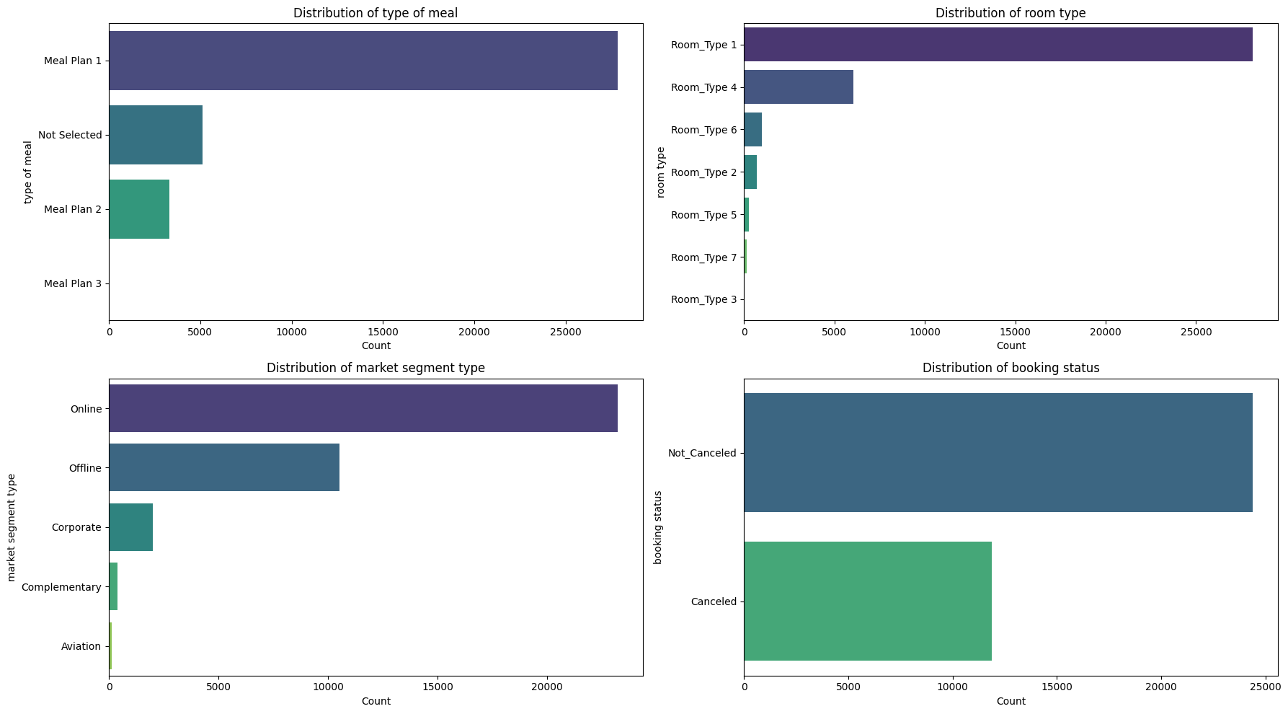
3. Exploratory Data Analysis (EDA)
Analyze the dataset
Understand booking patterns.
Explore the distribution of categorical variables.
Identify factors related to booking cancellations.
Detect trends and relationships between variables.
Discover patterns before building machine learning models.
06
Notes:
"In the Exploratory Data Analysis stage, we explored the distribution of important categorical features. Most customers selected Meal Plan 1, Room Type 1 was the most frequently booked room, Online was the dominant market segment, and most bookings were not canceled. These insights help us understand customer behavior before training the machine learning models."

Slide 7
4. Data Processing
1. Encoding Categorical variables
3. Feature Select
• Separate target value (booking_status).
To help in reducing overfitting, improving accuracy, and reducing training time.
• Drop irrelevant identifier columns like booking_ID and date of reservation which requires specific handling or feature engineering not directly part of standard encoding for nominal categories.
4. Split Feature and Target & train/test split
Split the data into training and testing sets to evaluate our model's performance on unseen data. A common split ratio is 80% for training and 20% for testing.
2. Feature Scaling
Re-apply StandardScaler to ensure numerical features have a mean of 0 and a standard deviation of 1.
07

Slide 8
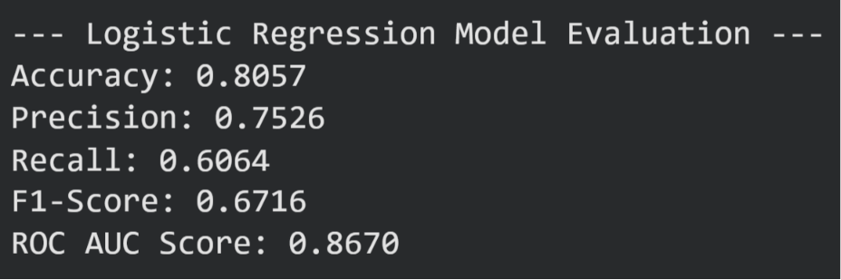
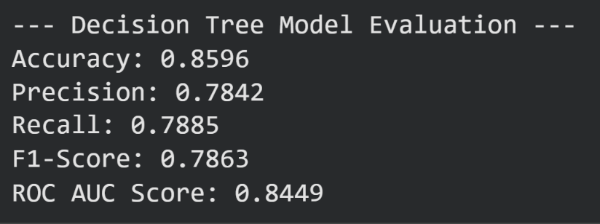
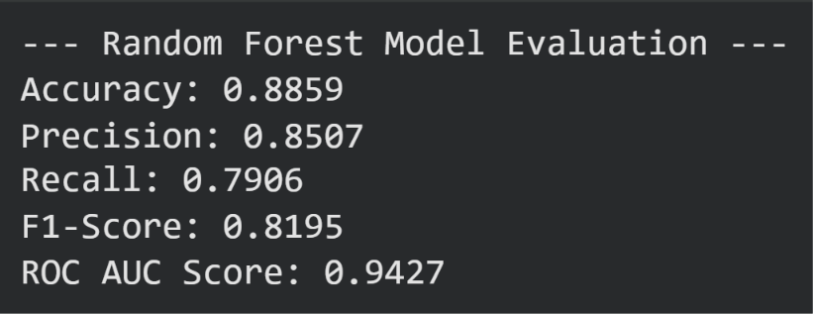
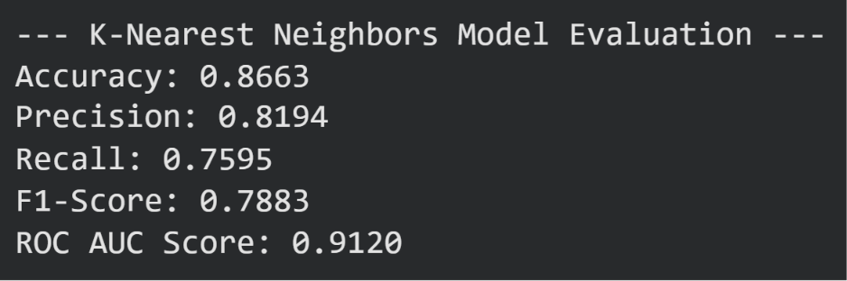
5. Methodology: Model Algorithms Train Evaluation
Logistic Regression
Decision Tree
Random Forest
K-Nearest Neighbors(KNN)
08

Slide 9
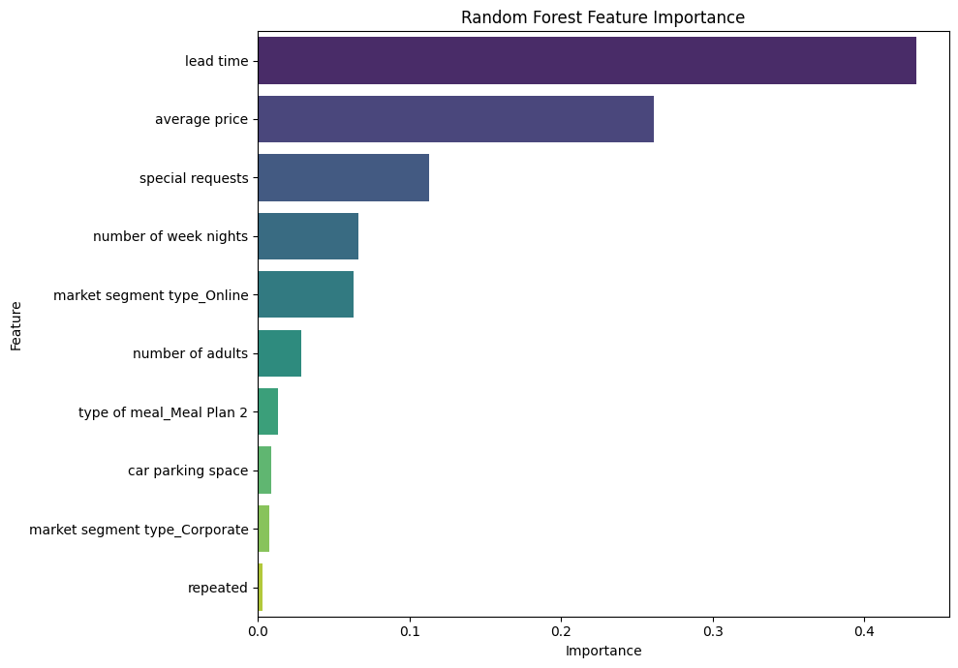
5. Methodology: Feature Importance
Random Forest
09

Slide 10
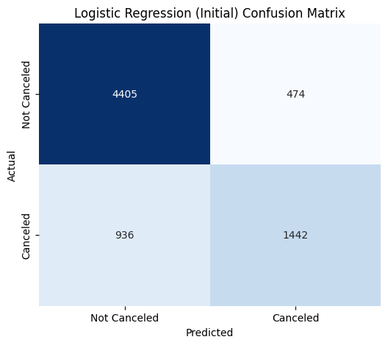
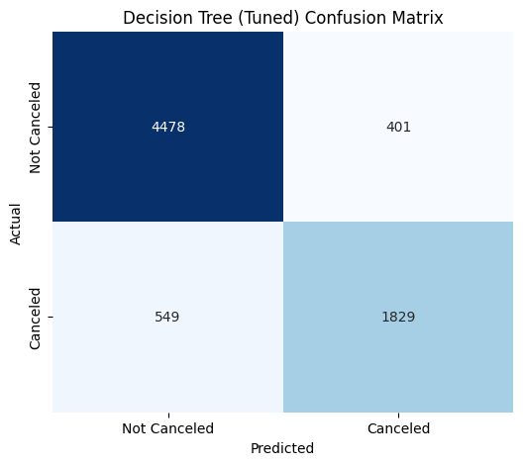
5. Methodology: Train Models Tuned and Confusion Matrix
Logistic Regression (Initial Model)
Accuracy: 0.8057 (80.57%)
Precision: 0.7526
Recall: 0.6064
F1-Score: 0.6716
ROC AUC Score: 0.8670
Decision Tree (Tuned)
Accuracy: 0.8691(86.91%)
Precision: 0.8202
Recall: 0.7691
F1-Score: 0.7938
ROC AUC Score: 0.9260
10

Slide 11


5. Methodology: Train Models Tuned and Conclusion Matrix
Random Forest (Tuned)
Accuracy: 0.8891(88.91%)
Precision: 0.8633
Recall: 0.7860
F1-Score: 0.8228
ROC AUC Score: 0.9470
K-Nearest Neighbors (Tuned)
Accuracy: 0.8780(87.8%)
Precision: 0.8370
Recall: 0.7796
F1-Score: 0.8073
ROC AUC Score: 0.9263
11

Slide 12
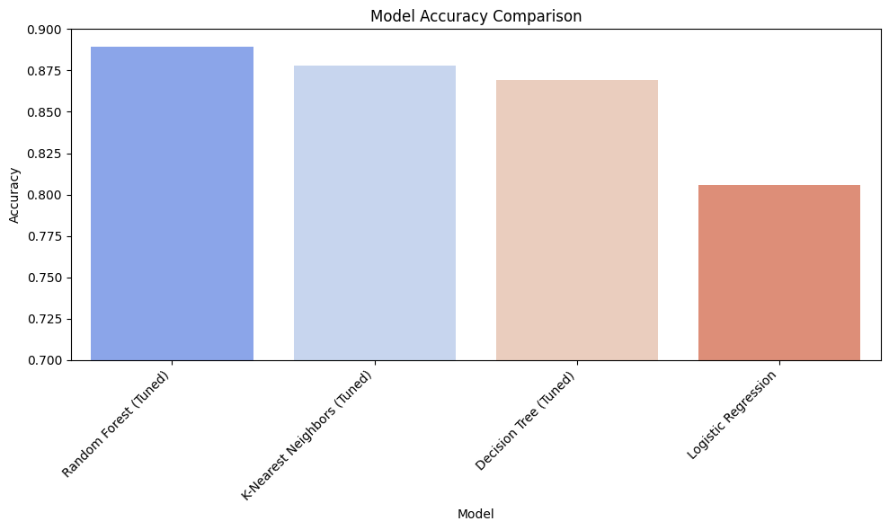
5. Methodology: Accuracy Comparison Bar Chart
A bar chart comparing the accuracy of all models provides a quick and intuitive understanding of their relative performance.
12

Slide 13
6. Findings
 | Accuracy | Precision | Recall | F1-Score | ROC-AUC Score
Logistic Regression | 0.8057 | 0.7526 | 0.6064 | 0.6716 | 0.8670
Decision Tree (Tuned) | 0.8691 | 0.8202 | 0.7691 | 0.7938 | 0.9260
Random Forest (Tuned) | 0.8891 | 0.8633 | 0.7860 | 0.8228 | 0.9470
K-Nearest Neighbors (Tuned) | 0.8780 | 0.8370 | 0.7796 | 0.8073 | 0.9263
13

Slide 14

7. Conclusion
Compared multiple machine learning models for booking cancellation prediction.
Found the Tuned Random Forest to be the best-performing model.
Achieved the highest accuracy and overall prediction performance.
14

Slide 15


Data Sources
Hotel Booking Cancellation Prediction
Source: kaggle.com
Hotel_cancellation_prediction.ipynb - Colab
Source: google_colab.com
15

Slide 16
Questions & Discussion
Thank you for reviewing the Hotel Booking Cancellation Analytics & Predictive Modeling Defense.
16

